Slide 1




Home Credit Default Risk
Group 13(Phase -2)
William Cutchin
wcutchin@iu.edu
Krisha Mehta
krimeht@iu.edu
Kunal Mehra
kumehra@iu.edu
Kalyani Malokar kmalokar@iu.edu

Slide 2
Outline:
•Project Description
•Summary Visual EDA
•ML Pipeline
•Modeling Pipeline Description
•Results and discussion of results
•Conclusion and next steps

Slide 3
Project Description
Home Credit Group looks to use alternative data that will help them decide if they are able to lend to these individuals and to predict their client’s repayment abilities.
Here we are using various machine learning and statistical models to get these predictions.
We will be using Logistic Regression and Random Forest Classifier and Decision Tree to determine these predictions.
Our goal in this phase is to perform EDA,do the visualizations on that and train models using best parameters and settings.
We will be preprocessing and cleaning the data and build pipelines after we examine the accuracies of the explored pipelines.

Slide 4
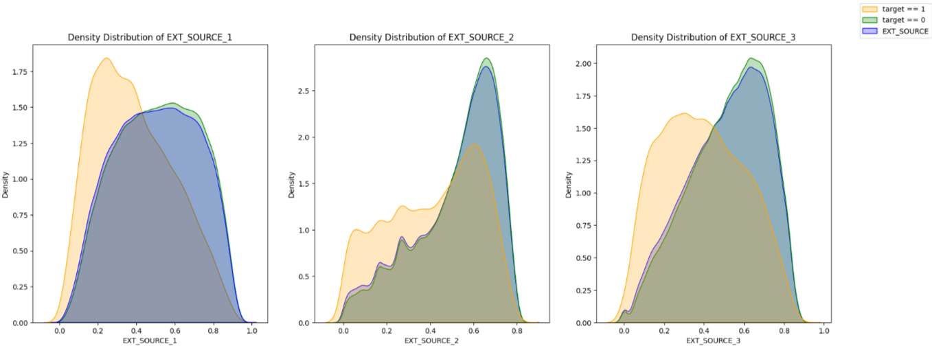
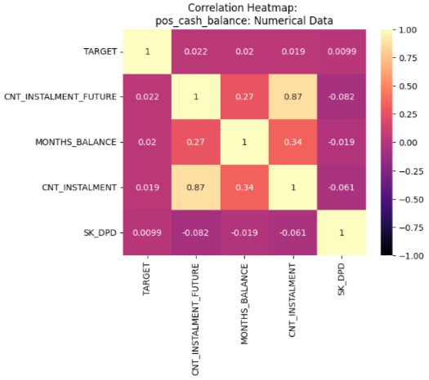
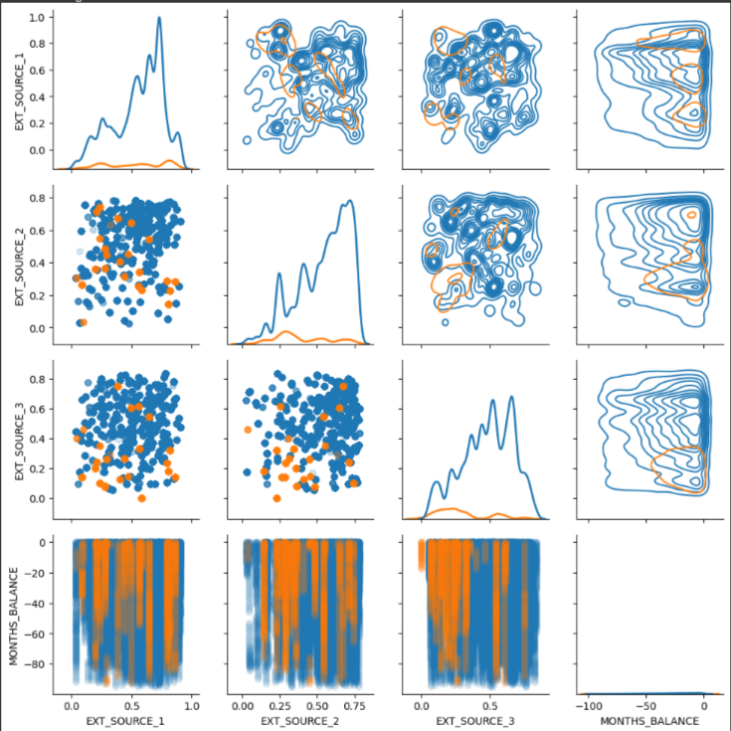
Summary Visual EDA
The use of Kernel Distribution Estimation was extremely helpful when examining separation of target distributions
Heatmaps were essential in understanding correlations and feature selection

Slide 5
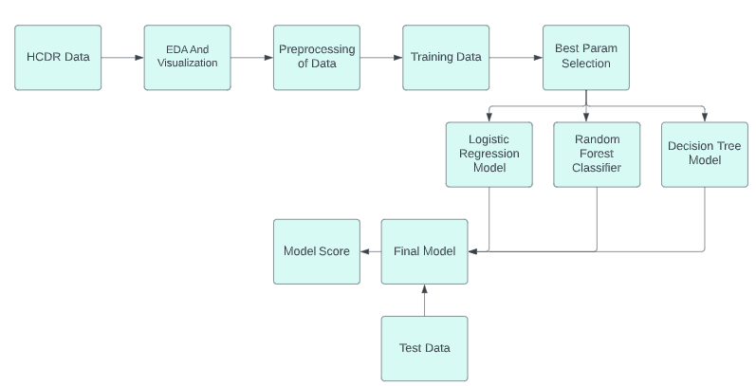
ML Pipeline

Slide 6
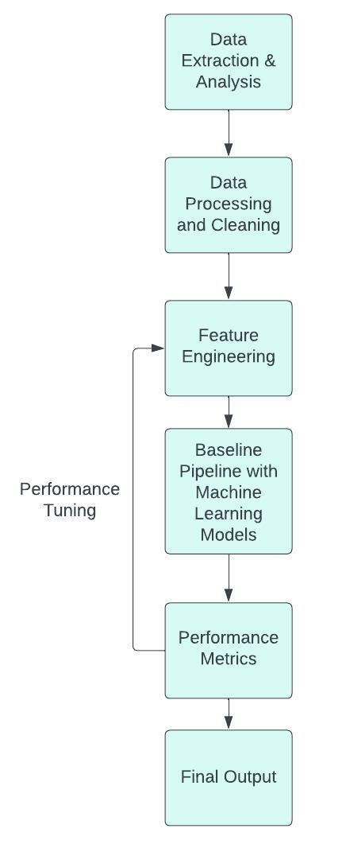
Pipeline Overview
Pipeline includes the following steps:
Extract and analyse the data with data preprocessing and cleaning.
Separate the features into numerical and categorical data.
Impute the numerical and categorical features using the pipeline.
Feature engineering.
Evaluating the performance metrics.
Getting the final output

Slide 7
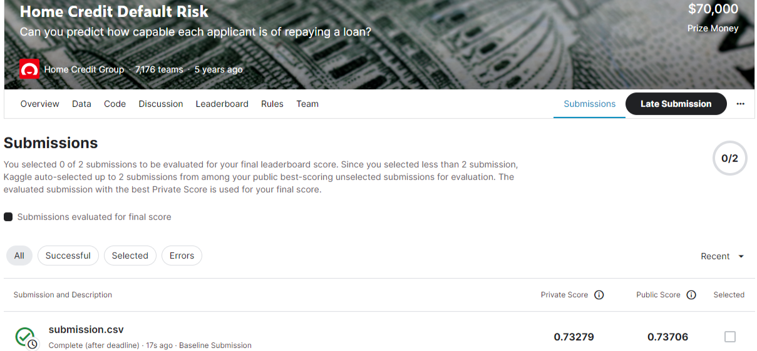
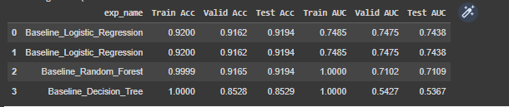
Results and discussion of results
We can see that logistic regression has been the most successful for our data and predicting the parameters.

Slide 8
4Ps: Past, Present, Planned, Problems
Past: Context of the Project
The HCDR Project aims to predict if customers of Home Credit are able to repay a loan without a recorded credit score or agreed upon metric.
Present: What we have done
Explored the data through visualizations understanding each variable and how their correlation to the target matters to the problem.
Shown this knowledge in the deployment of our baseline ML pipelines with RandomForestClassifier and Logistic Regression.
Planned:
Fine tune hyperparameters and rethink how we can efficiently merge our desired features.
Problems:
Ram usage and large data sets not being able to be accurately merged On the desired scale.

Slide 9
Conclusion and next steps
In this phase we merged the datasets and extracted all possible features.
We preprocessed the data and found the most relevant features to the Target variable and prediction.
We then created our own features based on the most correlated features which contributed to the prediction.
We built baseline pipelines and tries to improve the test accuracy.
In our next phase, we will be performing additional feature engineering along with hyperparameter tuning, feature selection with analysis of feature importance, and ensemble methods.

